Slide 1
Understanding File Permissions and Ownership

Slide 2
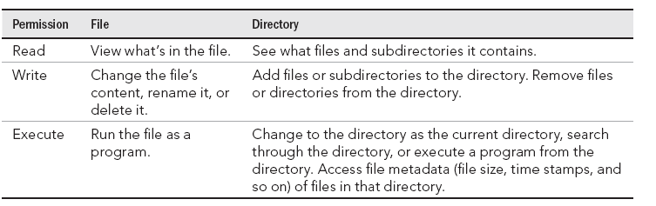

Setting Read, Write, and Execute Permissions

Slide 3
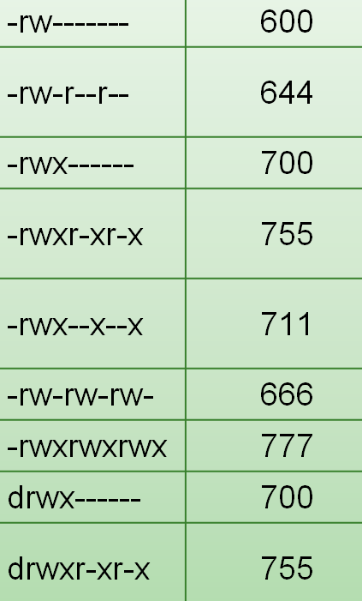

Slide 4
chmod – Change File Mode
only the file’s owner or the superuser can change the mode of a file or directory.
chmod supports two distinct ways of specifying mode changes: octal number representation, or symbolic representation.

Slide 5
chmod [options] octal-mode file-list
chmod [options] symbolic-mode file list
-R | sets the permission for a directory (and the files it contains)

Slide 6
Changing permissions with chmod (numbers)
  chmod 777 file
  chmod 755 file
  chmod 644 file
  chmod 000 file
  chmod -R 755 $HOME/myapps

Slide 7
Changing permissions with chmod (letters)
  plus (+) and minus (–) signs
  user (u), group (g), other (o), and all users (a)
  read (r), write (w), and execute (x)

Slide 8
chmod a-w file
  r-xr-xr-x
chmod o-x file
  rwxrwxrw-
chmod go-rwx file
  rwx------
chmod u+rw files
chmod a+x files
chmod ug+rx files
chmod -R o-w $HOME/myapps

Slide 9
Changing permissions with chmod (letters)
Operator(=):
  only the specified permissions are to be applied and that all others are to be removed.
  Privilege(u,g and o)
  chmod u=rwx
  chmod g=u
  chmod go=

Slide 10
chmod +r myfile ⬅➔ chmod a+r myfile
chmod +x myfile ⬅➔ chmod a+x myfile
chmod +w myfile ⬅➔ chmod u+w myfile

Slide 11
Setting default file permission with umask
  When you create a file as a regular user, it’s given permission rw-rw-r-- by default. A directory is given the permission rwxrwxr-x.
  For the root user, file and directory permission are rw-r--r-- and rwxr-xr-x, respectively
  These default values are determined by the value of umask.

Slide 12
umask
  0002
$ umask 777 ; touch file01 ; mkdir dir01 ; ls -ld file01 dir01
d---------. 2 joe joe 6 Dec 19 11:03 dir01
----------. 1 joe joe 0 Dec 19 11:02 file01
$ umask 000 ; touch file02 ; mkdir dir02 ; ls -ld file02 dir02
drwxrwxrwx. 2 joe joe 6 Dec 19 11:00 dir02/
-rw-rw-rw-. 1 joe joe 0 Dec 19 10:59 file02
$ umask 022 ; touch file03 ; mkdir dir03 ; ls -ld file03 dir03
drwxr-xr-x. 2 joe joe 6 Dec 19 11:07 dir03
-rw-r--r--. 1 joe joe 0 Dec 19 11:07 file03
file 666
directory 777

Slide 13
Changing file ownership
  # chown joe /home/joe/memo.txt
  # ls -l /home/joe/memo.txt
  -rw-r--r--. 1 joe root 0 Dec 19 11:23 /home/joe/memo.txt
  # chown joe:joe /home/joe/memo.txt
  # ls -l /home/joe/memo.txt
  -rw-r--r--. 1 joe joe 0 Dec 19 11:23 /home/joe/memo.txt
  chown -R joe:joe /media/myusb

Slide 14
special permissions:
  The setuid bit(SUID)
  The setgid bit(SGID)
  Sticky bits

Slide 15
SUID
  This bit is present for files which have executable permissions
  it will set its permissions to that of the user who created it (owner), instead of setting it to the user who launched it.

Slide 16
SGID
  The setgid affects both files as well as directories.
  When used on a file, it executes with the privileges of the group of the user who owns it instead of executing with those of the group of the user who executed it.
  When the bit is set for a directory, the set of files in that directory will have the same group as the group of the parent directory, and not that of the user who created those files
  This is used for file sharing

Slide 17
Sticky bit
  When a directory has the sticky bit set, its files can be deleted or renamed only by the file owner, directory owner and the root user

Slide 18
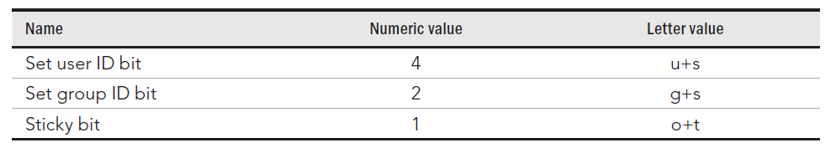
To locate the setuid, look for an ‘s’ instead of an ‘x’ in the executable bit of the file permissions
chmod u+s
chmod u-s
To locate the setgid bit, look for an ‘s’ in the group section of the file permissions,
chmod g+s
chmod g-s
look for a ‘t’ character in the file permissions to locate the sticky bit.
chmod +t
chmod -t

Slide 19
chmod 4755 ~/bin/myapp
  chmod 2755 /home/groupspace
  chmod 1755 /home/share

Slide 20
Setting permissions with Access Control Lists
  The Access Control List (ACL) feature was created so regular users could share their files and directories selectively with other users and groups
  To add ACLs to a fi le, you use the setfacl command; to view ACLs set on a file, you use the getfacl command

Slide 21
Setting ACLs with setfacl
  setfacl -m rules filename
  u:uid:perms
  g:gid:perms
  o:perms
  setfacl -m u:bill:rw /tmp/memo.txt
  setfacl -m g:sales:rw /tmp/memo.txt

Slide 22
  [mary]$ getfacl /tmp/memo.txt
  # file: tmp/memo.txt
  # owner: mary
  # group: mary
  user::rw
  user:bill:rw
  group::rw
  group:sales:rw
  mask::rw
  other::r--
the regular group permission on the file sets a mask of the maximum permission an ACL user or group can have on a file.

Slide 23
Setting default ACLs
  [mary]$ mkdir /tmp/mary
  [mary]$ setfacl -m d:g:market:rwx /tmp/mary/
  [mary]$ getfacl /tmp/mary/

Slide 24
  # file: tmp/mary/
  # owner: mary
  # group: mary
  user::rwx
  group::rwx
  other::r-x
  default:user::rwx
  default:group::rwx
  default:group:sales:rwx
  default:group:market:rwx
  default:mask::rwx
  default:other::r-x

Slide 25
Create a directory in your home directory called projects. In the projects directory, create nine empty files that are named house1, house2, house3, and so on to house9. Assuming there are lots of other files in that directory, come up with a single argument to ls that would list just those nine files.
2. Make the $HOME/projects/houses/doors/ directory path. Create the following empty files within this directory path (try using absolute and relative paths from your home directory):
$HOME/projects/houses/bungalow.txt
$HOME/projects/houses/doors/bifold.txt
$HOME/projects/outdoors/vegetation/landscape.txt
3. Copy the files house1 and house5 to the $HOME/projects/houses/ directory.
4. Recursively copy the /usr/share/doc/initscripts* directory to the $HOME/projects/ directory. Maintain the current date/time stamps and permissions.
Remove the fi les house6, house7, and house8 without being prompted.
Move house3 and house4 to the $HOME/projects/houses/doors directory.
Remove the $HOME/projects/houses/doors directory and its contents.
Change the permissions on the $HOME/projects/house2 fi le so it can be read and written by the user who owns the file, only read by the group, and have no permission for others.
Recursively change permissions of the $HOME/projects/ directory so nobody has write permission to any files or directory beneath that point in the file system.

